Slide 1
New Zealand Tourism and Accommodations Time Series Analysis
Timothy Lu
Springboard Capstone 2022

Slide 2
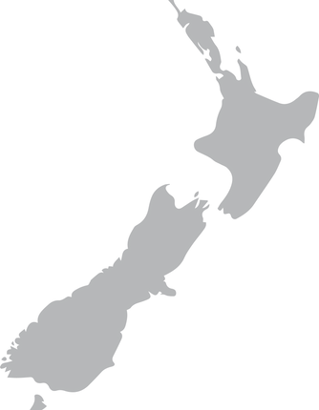
Goals of the Project
Post COVID-19 is seeing the return of visitors to New Zealand
Time series analysis helps us understand trend and forecast into the future
Understanding travel trends and demands is critical for governments
Key Question:
What can the government of New Zealand expect regarding visitors?

Slide 3

Data Source
Data directly from New Zealand Government via Infoshare (https://infoshare.stats.govt.nz/Default.aspx)
Data collected:
Visitor data from foreign countries to New Zealand airports from 1978-2022
Accommodations data for regions in New Zealand from 2001-2019

Slide 4
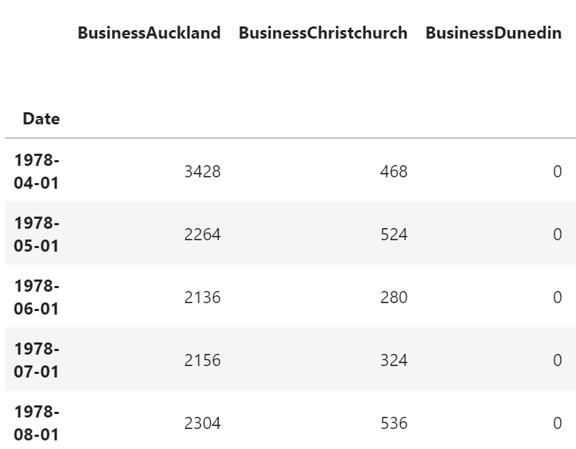
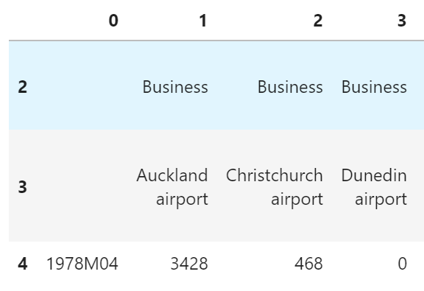
Data Wrangling
GOALS: Cleaning collected data and fill in missing data as needed
Data was univariate (purely time series)
Removed excess text describing the dataset from government
Inputted 0’s for missing data (some regions started collecting data later)
Converting date format to datetime (originally 1978M01)

Slide 5
Exploratory Data Analysis
GOAL: Observe trends and select datasets for analysis
Accommodations dataset broken down to components:
Type of accommodation: Hotel, Motel, Backpacker, Holiday Park, All Accommodations
Region: Various New Zealand Regions
Arrivals dataset broken down to components:
Reason for travel: Business, Holiday/Vacation, Visiting Friends, Total Visitors
Airport: Various New Zealand Airports
Decision: Pick time series with complete data and parallels in both datasets
Compare across all types for similar regions

Slide 6
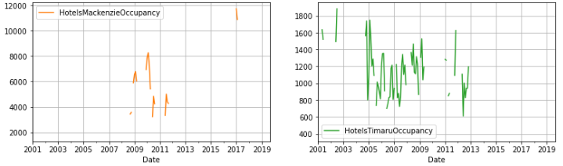
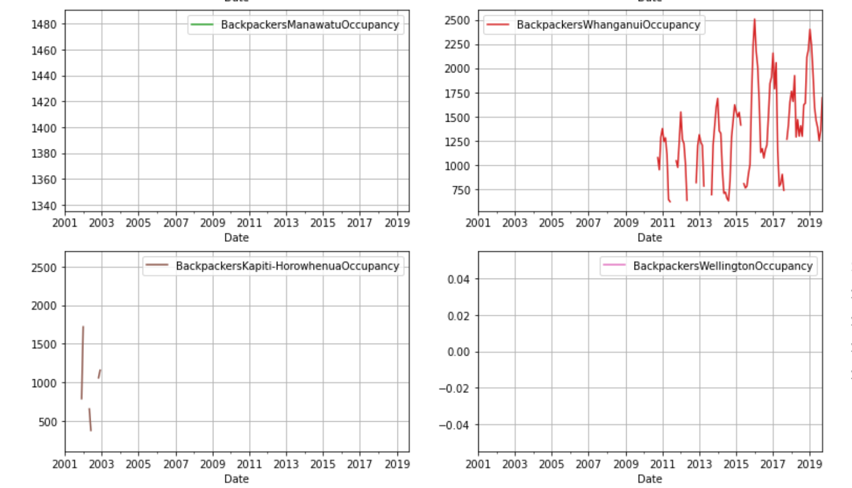
Accommodations Exploration
Hotels data broken for some regions – not modeling for these regions
Backpackers data quite sparse for many regions as well
Holiday parks very cyclical

Slide 7
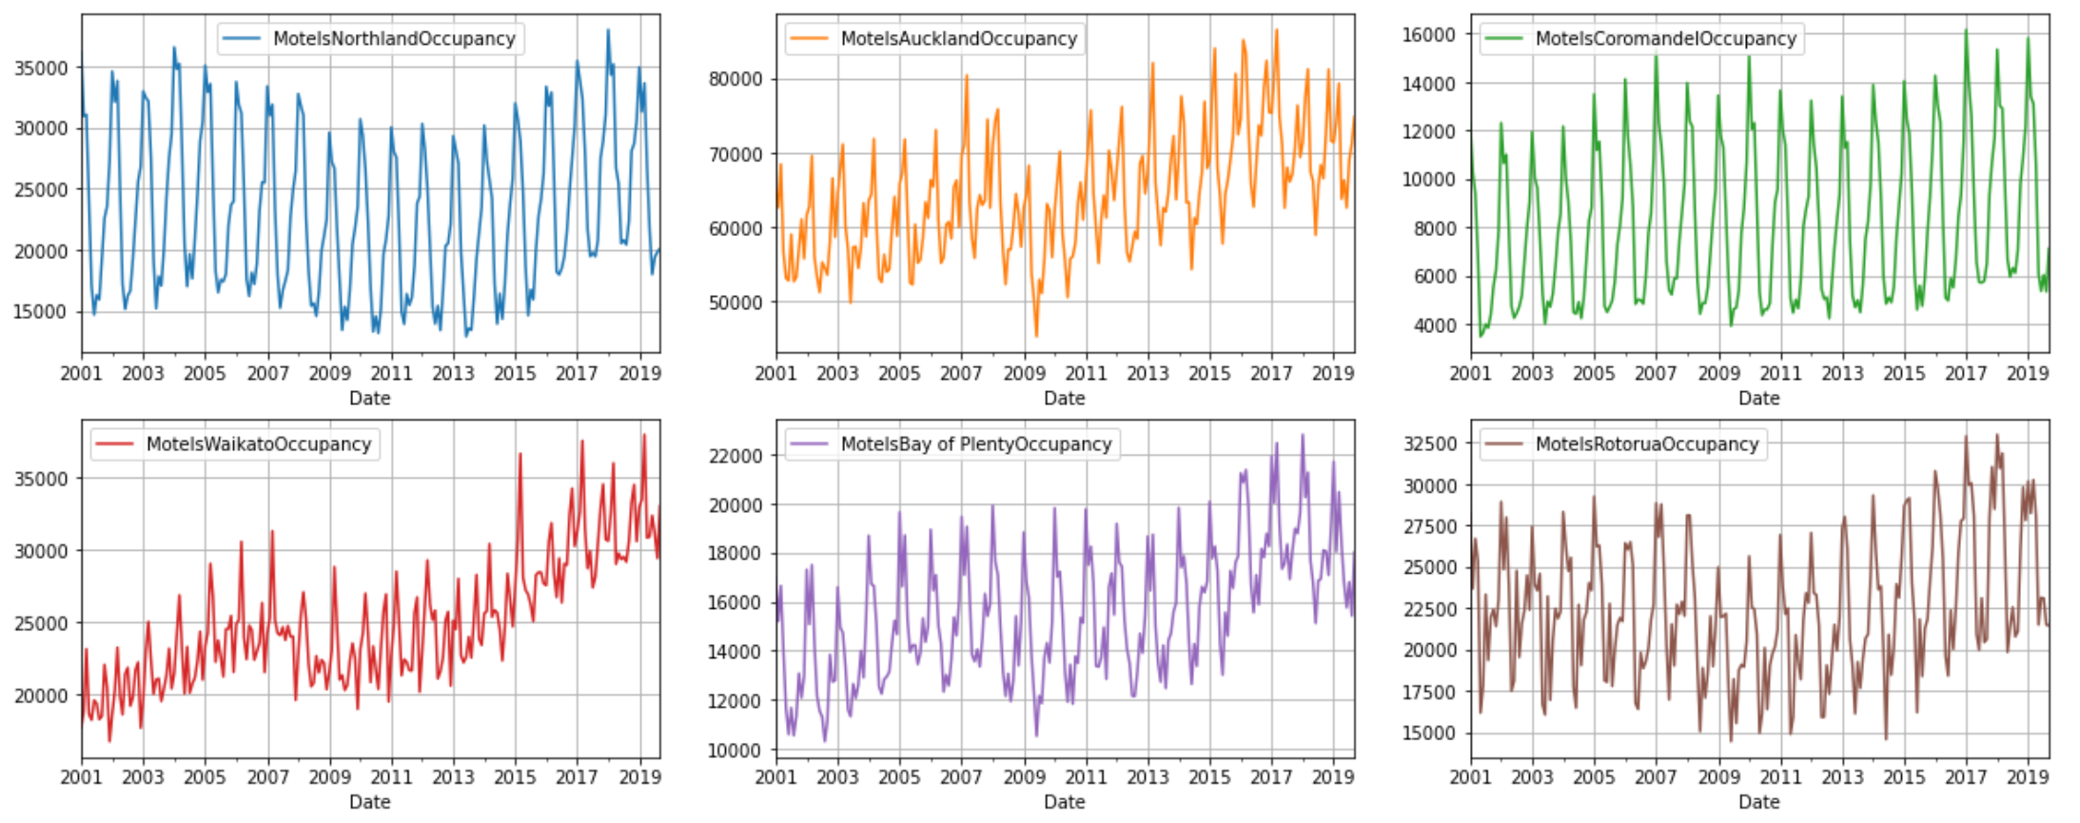
Accommodations Exploration
Final regions of interest:
Regions: Auckland, Canterbury, Wellington, Queenstown, Total New Zealand
Types of Accommodation: Motels, Hotels, All Accommodations
Regions chosen for their parallels with airports and data consistency
Types of accommodation chosen for their market share and continuous time series data
Observed seasonality across regions and trending growth in some accommodation types

Slide 8
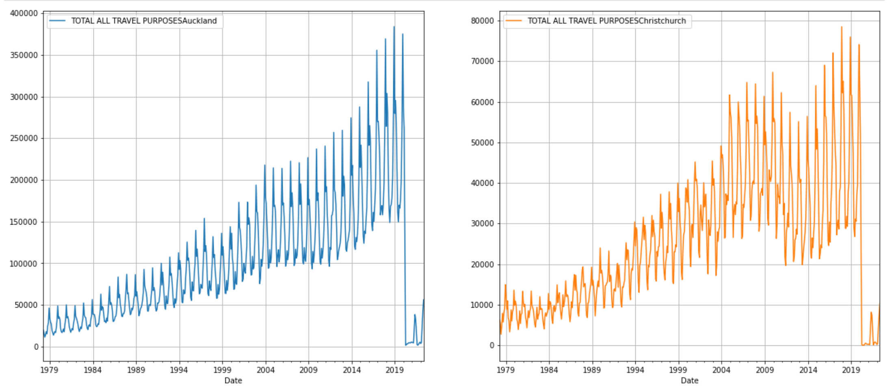
Tourism Arrivals Exploration
Greatly impacted by COVID-19 Data
Very few data sets has missing data, 0s are due to either COVID or opening later
Total data noisy, when broken down by reason, less noisy

Slide 9
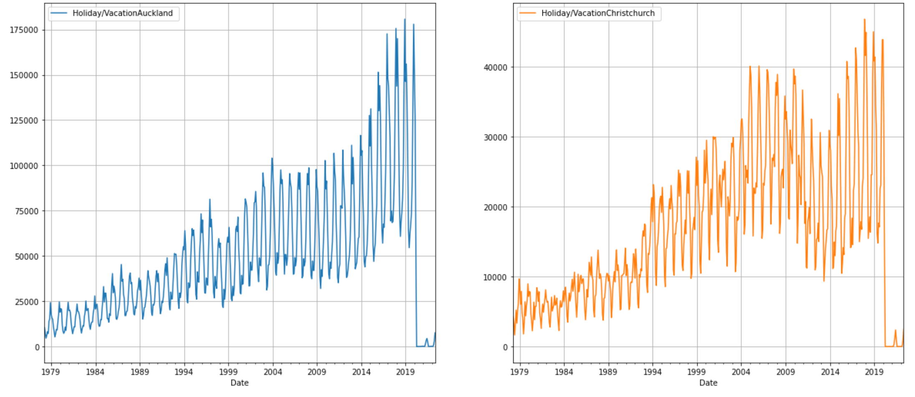
Tourism Arrivals Exploration
We can see seasonal trends and some trending growth
Regions: Auckland, Christchurch (Canterbury), Queenstown, Wellington, All New Zealand
Reasons: Business, Holiday, Visiting Friends, All Reasons
Regions chosen to parallel Accommodations and to reduce the amount of models generated

Slide 10
Pycaret Modeling
To increase breadth of modeling search, utilized pycaret as initial “model trialing”
Pycaret (https://pycaret.org/) allows for the testing of multiple time series and looks for the model with the best metrics for your time series
Great initial exploration of models and to learn about more models
Can generate “final models” with hyperparameter tuning

Slide 11
Pre-processing
Minimal pre-processing needed
No missing values means no imputation needed
Data is monthly with minimal noise and some models perform smoothing
Primary outliers are due to historic events (COVID-19)
Generally, differencing and removing seasonal residual is a big component (stationarity)
Some pre-packaged models (SARIMAX) do that differencing for us
Many models will deseasonalize or use seasonal information to its advantage

Slide 12
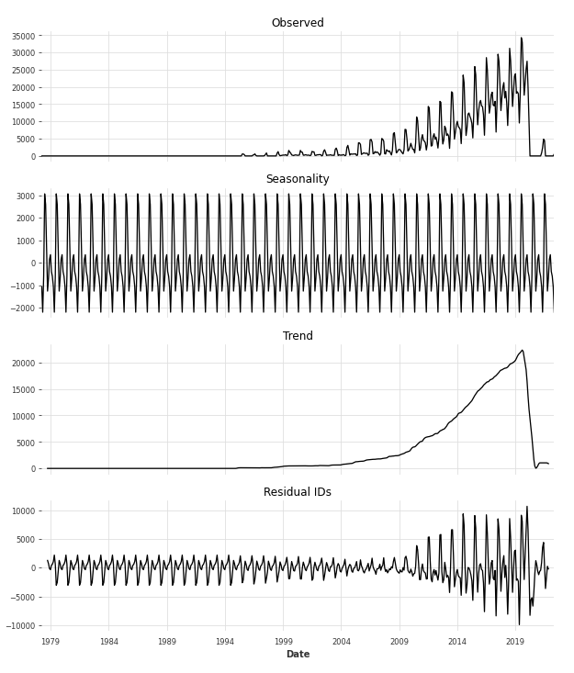
Modeling
Decompose seasonality and trends to properly choose model parameters
Tourism data had to deal with COVID-19
Greatly impacted our modeling
Accommodations data utilized more machine learning techniques
Had to create custom functions for some models

Slide 13
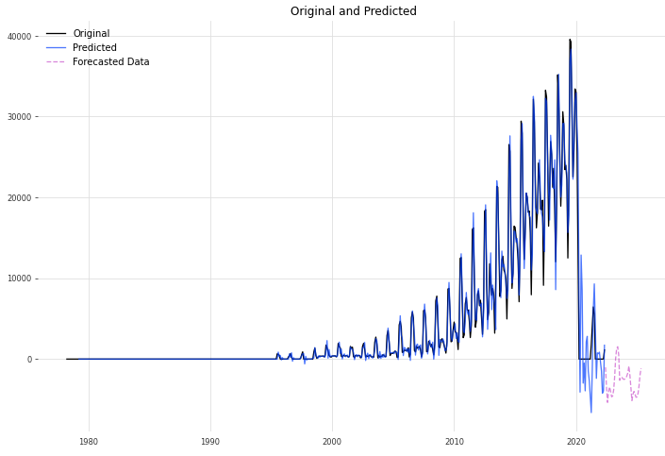
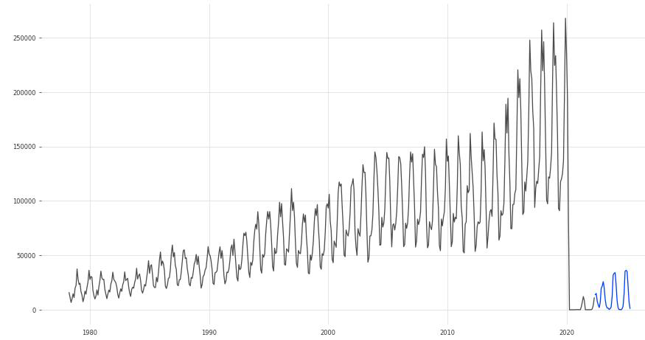
Tourist Data Modeling
Drop in tourism caused by COVID-19 caused many models to struggle
Unconstrained, conventional models like SARIMAX forecasted negative visitors
Queenstown Total Visitors data extraordinarily poor forecasting
Some models like BATS and ETS performed well
SARIMAX model on Queenstown Total Tourism
BATS model on All Tourism New Zealand

Slide 14
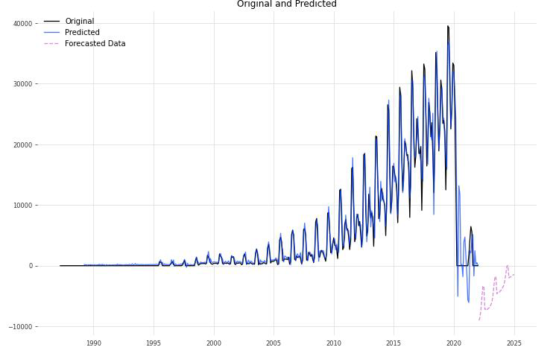
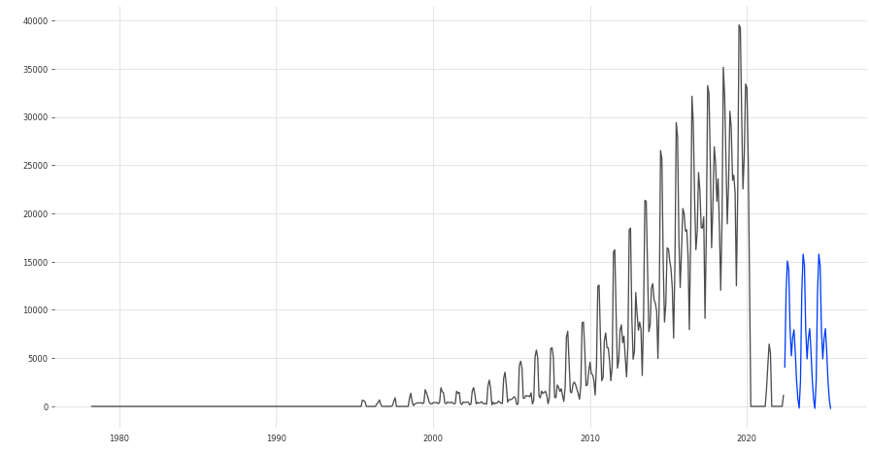
Tuning/Changing Models
Two attempts to improve forecasting on Queenstown Total Tourism
Add Exogenous factors to SARIMAX model (GDP)
Did not resolve negative forecasting BUT reinforced upward trend
Use BATS modeling on the timeseries – solved negative forecasting issue
SARIMAX model on Queenstown Total Tourism
w/ GDP as exog
BATS model on Queenstown Total Tourism

Slide 15
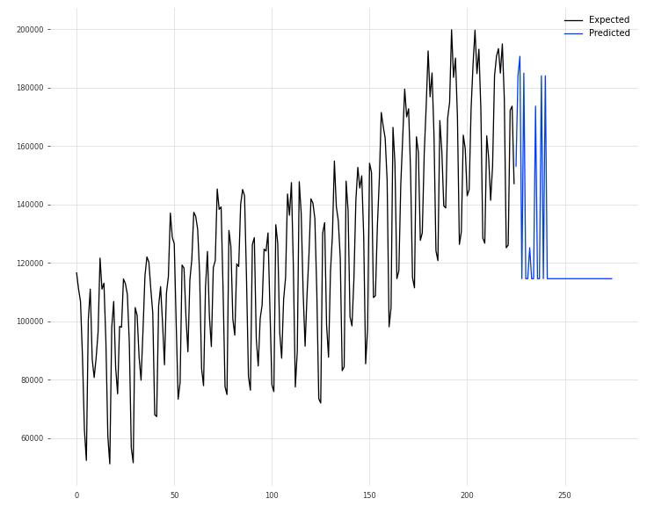
Accommodations Models
Did not have COVID-19 data
Overall models performed well according to pycaret predictions
Prophet needed to be coerced into monthly predictions
AdaBoost Machine learning models had interesting behavior, would prefer other models

Slide 16
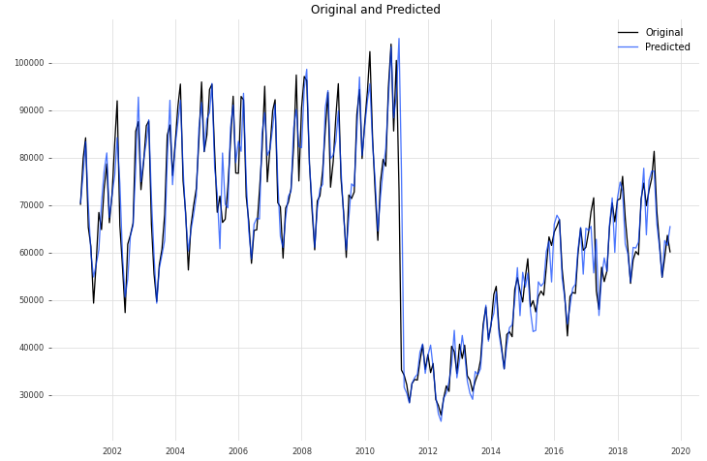
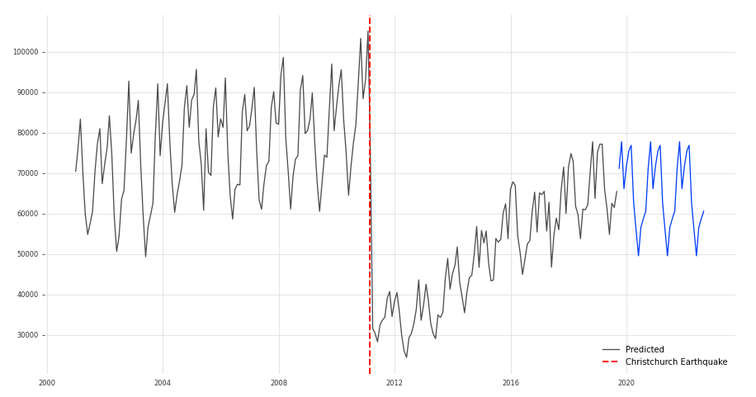
Accommodations Christchurch Hotel Model
February 2011, Christchurch Earthquake – major event
Caused a huge plummet in tourism
Slight parallel to COVID-19 data and we can observe model performance
Initially a lag and difficulty with predictions but corrected itself after some seasonal cycles

Slide 17
Recommendations
COVID-19 Data should tentatively be modeled using BATS to prevent negative forecasts
New Zealand Government should update data as quickly as possible
New data will allow time series models to more accurately predict as we exit the COVID-19 pandemic
When new data is given in September 2022, update the models
Accommodations industry should prepare for an upcoming holiday season

Slide 18
Constraints and Further Study
Time series data not up-to-date thus limiting forecasting power
Accommodations data only until 2019, could use more recent data to study
Utilizing different exogenous variables to assist in modeling tourism data
Could help with the pandemic forecasting
Pycaret (and similarly DARTS) are a great way to begin initial exploration into time series
Still perform more modeling and manual tuning

Slide 19
Thank you
Timothy Lu
Report: https://github.com/naturesbless/Tourism-Forecasting/blob/main/Proposal%20and%20Reports/New_Zealand_TimeSeries_Capstone_Report.pdf
Github: https://github.com/naturesbless/Tourism-Forecasting

